Slide 2
Notes:
People all over the world have many different ideas about what it takes to get to Heaven – Beliefs, Paths, Religions
Heaven Doesn’t Belong to Us …
It’s not the Pentecostal Way or the Baptist Way that Gets you there – Its Gods Way and God’s Way is the Bible Way!

Slide 3
1 Corinthians 8:3
But if any man LOVE God, the same is KNOWN of him.

Slide 4
The Christian Life is
One Big Puzzle.

Slide 5
How Do We Lead
Someone to the
Lord?

Slide 6
Matthew 7:12-14
Finding The Narrow Way

Slide 7
Is the Narrow Way Hidden?
The Bible Says FEW will FIND it.
If You’re Going to Find Something,
You have to Look for it – Seek it.
It’s Not Right in Front of your Face.
Most People Won’t Find It.
How Wide and How Narrow?

Slide 8
Matthew 7:21-23
I Never Knew You

Slide 9
Matt 7: 21-23
21 Not every one that saith unto me, Lord, Lord, shall enter into the kingdom of heaven; but he that doeth the will of my Father which is in heaven.
22 Many will say to me in that day, Lord, Lord, have we not prophesied in thy name? and in thy name have cast out devils? and in thy name done many wonderful works?
23 And then will I profess unto them, I never knew you: depart from me, ye that work iniquity.

Slide 10
Matt 7: 21-23
21 Not every one that saith unto me, Lord, Lord, shall enter into the kingdom of heaven; but he that doeth the will of my Father which is in heaven.
22 Many will say to me in that day, Lord, Lord, have we not prophesied in thy name? and in thy name have cast out devils? and in thy name done many wonderful works?
23 And then will I profess unto them, I never knew you: depart from me, ye that work iniquity.

Slide 11
Matt 7: 21-23
21 Not every one that saith unto me, Lord, Lord, shall enter into the kingdom of heaven; but he that doeth the will of my Father which is in heaven.
22 Many will say to me in that day, Lord, Lord, have we not prophesied in thy name? and in thy name have cast out devils? and in thy name done many wonderful works?
23 And then will I profess unto them, I never knew you: depart from me, ye that work iniquity.

Slide 12
Many Will Say, Lord Lord
Same Greek Word “Many” as Above
They Were Christian Believers (Lord)
Not Just Pew Warmers
Actively Serving – Very Surprised
Jesus Said I NEVER Knew You
The Most Horrible Words to Hear

Slide 13
How Could They Come
So Close and Not
Be Saved?

Slide 14
REMEMBER
Jesus is talking about
Judgment Day, a
Day Beyond Today!

Slide 15
Matt 7: 21-23
21 Not every one that saith unto me, Lord, Lord, shall enter into the kingdom of heaven; but he that doeth the will of my Father which is in heaven.
22 Many will say to me in that day, Lord, Lord, have we not prophesied in thy name? and in thy name have cast out devils? and in thy name done many wonderful works?
23 And then will I profess unto them, I never knew you: depart from me, ye that work iniquity.

Slide 16
Jesus is talking about
People Today and
Tomorrow and Beyond

Slide 17
What? Do we have
Matt 7 Believers in our
Churches Today?

Slide 18
Even in Gospel
Preaching Churches?

Slide 19
Even in Independent, Fundamental, Temperamental, Bible Believing, Bible Teaching, Gospel Preaching, Chicken Eat’n, Baptist Churches?

Slide 20
Churches that Preach
The Gospel Every Sunday And give an Alter Call
After Every Service?

Slide 21
When people come
Forward during an Alter
Call, …

Slide 22
We are giving them all
The information they need
To get Saved right then
And there – Right?

Slide 23
Let’s Review That …

Slide 24
What Information do we
Give them?

Slide 25
We’re Giving them the
Gospel - Right?

Slide 26
Surely our Pastors are
Discerning enough to be
Able to sort out the “Tares from the Wheat” - Right?

Slide 27
In the Book of Matthew Chapter 13 Jesus gives us a parable that’s normally referred to as, “The Parable of the Wheat and the Tares”. This simple parable illustrates the clear difference between those who are true Christians (wheat) and those who are Not (tares) and what happens to each on Judgment Day (the harvest):

Slide 28
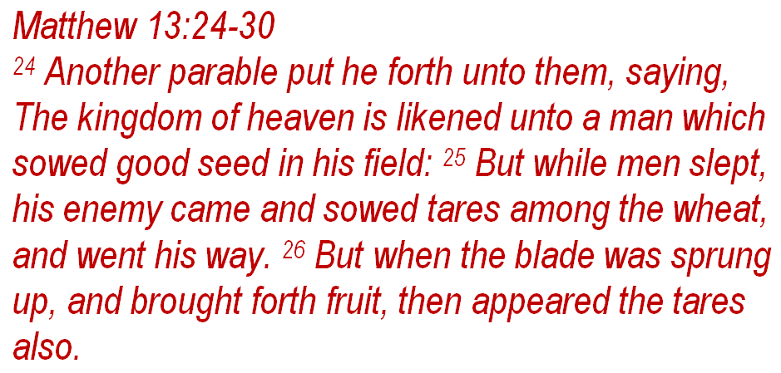

Slide 29
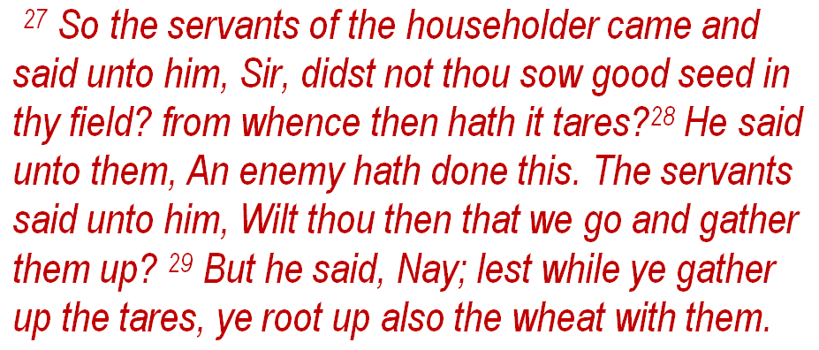

Slide 32
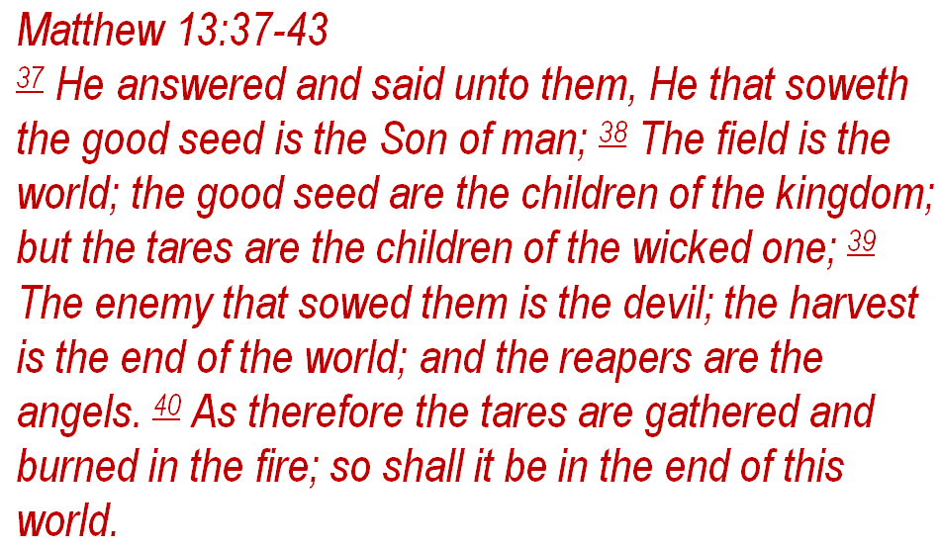

Slide 33
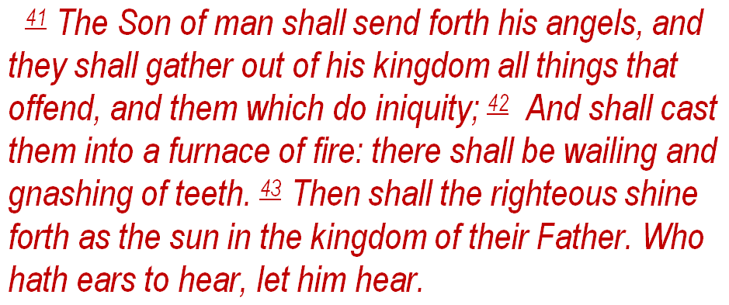

Slide 34
So, Who are these
Tares?

Slide 35
They include all
Matthew 7 Believers.

Slide 36
So, Do we Really have
Matt 7 Believers in our
Churches Today?

Slide 37
Dr. Billy Graham: Evangelist – Died in 2018 – Age 99
“There are many “False Converts” in American churches today. Some believe that they are saved and they are not. They prayed a prayer, they walked the aisle, maybe they filled out a decision card but that is not how someone is saved. That only gives people False Assurance and even with the sincerity of their decision, there is no Transformed Life. They can be sincere but sincerely wrong. This has created thousands of False Converts and today the tares and the wheat sit right next to each other in church and no one is warning them of the coming Wrath of God!”

Slide 38
A.W. Tozer: (Pastor / Author – Died in 1963 - 66)
“It is my opinion that tens of thousands of people,
if not millions, have been brought into some kind of Religious Experience by accepting Christ, and they have not been Saved.

Slide 39
Dr. D. James Kennedy: Fundamental Presbyterian
Pastor / Evangelist – Died in 2007 – Age 76
“The vast majority of people who are members of churches in America today are not Christians. I say that without the slightest fear of contradiction. I base it on empirical evidence of many years of examining many thousands of people.”

Slide 40
Leonard Ravenhill: (Evangelist – Died in 1994 - 87)
I doubt if 5% of professing Christians in America are truly Born Again – and that’s also true of England!
The Sinner’s Prayer has sent more people to Hell than all the Taverns in America.
(Preached on 2 Things His Whole Life: Prayer & Revival)

Slide 41
So, Wait a Minute, the Gospel has the Power
To Save - Right?

Slide 42
Romans 1:16
For I am not ashamed of the gospel of Christ: for it is the power of God unto salvation to every one that believeth; to the Jew first, and also to the Greek.

Slide 43
So, if the Gospel has the Power To Save – and we’re giving people the Gospel, then why are there so many Matt 7 Believers?

Slide 44
The First thing we do
Is blame the New Believer- “They Weren’t Really
Sincere”.

Slide 45
BUT – Is it Possible that
WE are Doing Something Wrong?

Slide 46
YES, we are and
Here’s the Problem …

Slide 47
“Good Churches”
Are Planting …

Slide 48
“TARES among
the WHEAT”!

Slide 49
Let’s Find out WHO
These Matt 7 Believers
Are …

Slide 50
Matt 7: 21-23
21 Not every one that saith unto me, Lord, Lord, shall enter into the kingdom of heaven; but he that doeth the will of my Father which is in heaven.
22 Many will say to me in that day, Lord, Lord, have we not prophesied in thy name? and in thy name have cast out devils? and in thy name done many wonderful works?
23 And then will I profess unto them, I never knew you: depart from me, ye that work iniquity.

Slide 51
1 Corinthians 8:3
But if any man LOVE God, the same is KNOWN of him.

Slide 52
God Knows All Them That Love Him.

Slide 55
Heaven Ready
Step 4

Slide 56
1 Corinthians 16:22
22 If any man love not the Lord Jesus Christ, let him be Anathema Maran-atha.

Slide 57
Heaven Ready
John/Romans
Booklet - Back

Slide 58
If the Greatest Command is to LOVE God then the Greatest SIN must be
Failure to do so!

Slide 59
So how did America’s
Churches get so far
Off Track?

Slide 60
Something Started Happening to America’s
Churches in the 1800s.

Slide 61
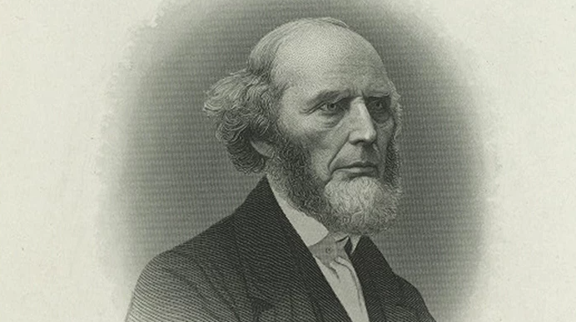
Charles Grandison Finney
( 19th Century Evangelist – Father of Modern Revivalism )

Slide 64
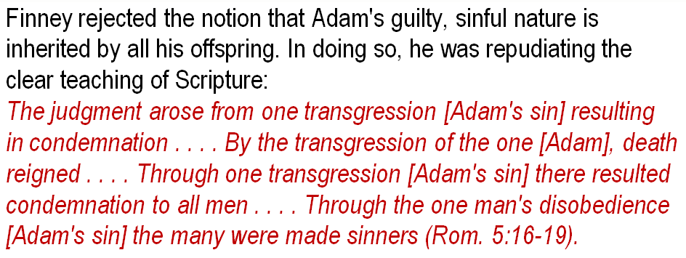

Slide 65
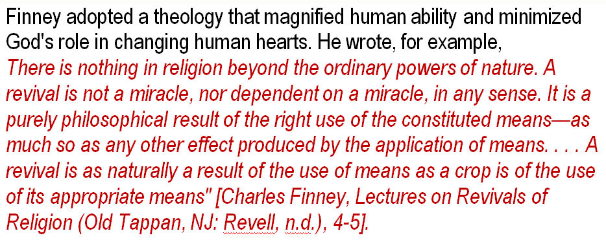

Slide 66
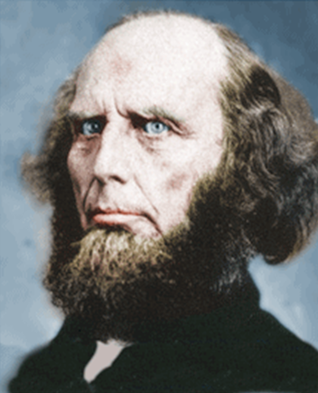
Lawyer – Went to Presbyterian Church.
Saved in the Woods – beside a log – Liquid Love
- Convinced the Way He Was Saved was the Right Way.
- Was a Traveling Evangelist – Guaranteed Results
Was a Marketer – Posters, Flyers and Signs - Circus
- Came up with the Idea of using Benches – Alter Call
Had People come Forward to make Instant Decisions
and get Instant Salvation.
Problem: Many of these “Converts” never came back.
Church Congregations began to change. They use to have a solid core of believers but it began to change.
They wanted excitement, entertainment and began to treat church much like a social club.
Many Churches began to realize that Finney had planted Tares among the Wheat.
D.L. Moody and Finney became Friends.

Slide 67
The Father of
“Easy Believism”.

Slide 68
Real Truth Real Quick
Video

Slide 69
Does God Love the
Whole World?

Slide 70
Does God Love Us
All the Same?

Slide 71
Is God’s Love Enough
to Save Us?

Slide 72
If God’s Love is Enough,
Why are People Going to
Hell Everyday?

Slide 73
Are There Different
Levels of God’s Love?

Slide 74
For Example; A Love
For a Group of People
Is Different than a
Love for Individuals.

Slide 75
As Christians,
We Love God’s People
But We Don’t Bring Them
Home to Live With Us.

Slide 76
We Have a Different
Kind of Love for the
People That Live
With Us.

Slide 77
We Have a Church Family
That We Love and a Personal Family That We Love But it’S Not the same
Kind of Love.

Slide 78
We Have a General Type
Of Love and we Have a Personal Type of Love.

Slide 79
Does God Have a General Love for All Of Mankind But
A Different - a “Conditional” Type of Love for Individuals?

Slide 80
A “General Love” for All
of Mankind But
A “Saving Love” for Individuals?

Slide 81
It’s True that
John 3:16 Says:

Slide 83
But it’s Also True That
Jesus Said in
John 14:21-23:

Slide 84
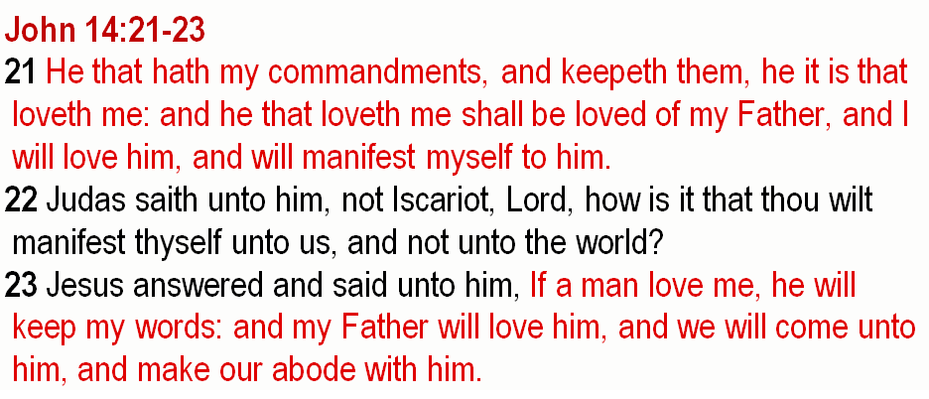

Slide 85
God’s Church Has
A Big Problem …

Slide 87
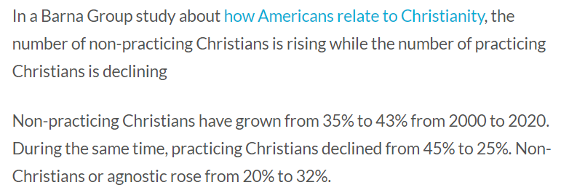

Slide 90
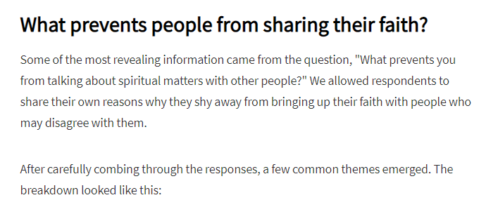

Slide 93
I Believe Our Country
Is in Big Trouble
Because Our Churches
Are in Big Trouble!

Slide 94
Clay
Christensen
Youtube Video

Slide 108
Notes:
People all over the world have many different ideas about what it takes to get to Heaven – Beliefs, Paths, Religions
Heaven Doesn’t Belong to Us …
It’s not the Pentecostal Way or the Baptist Way that Gets you there – Its Gods Way and God’s Way is the Bible Way!

